Slide 1

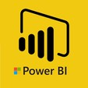
Hii,
Iam Siddhika
Welcome to Power BI Series
Part -43

Slide 2



Today Content
We focus only on the most used and important Dax Functions
I’m soo Excited.
Are you ready guys?
Meet DAX
COMMON FUNCTION CATEGORIES
6.DATE AND TIME FUNCTIONS
DATE
DATEDIFF
YEAR/MONTH/QUARTER

Slide 3

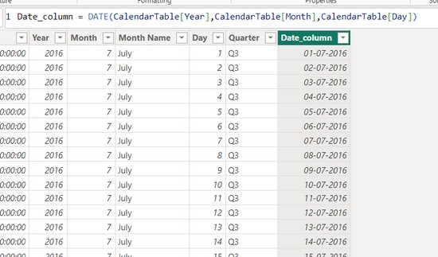

DATE
The DATE function in DAX is used to create a date value from individual year, month, and day components. This function is useful for constructing dates when you have these components as separate values.
Check next
Example also
Syntax
DATE(<year>, <month>, <day>)
Here just i’m taking for example to understand.
^{Example} Let's say you have a table called CalendarTable with separate columns for Year, Month, and Day, and you want to create a new column that combines these into a single date.
CalendarTable[Year]: References the Year column in the CalendarTable.
CalendarTable[Month]: References the Month column in the CalendarTable.
CalendarTable[Day]: References the Day column in the CalendarTable.
The DATE function combines these individual components into a date
value.

Slide 4

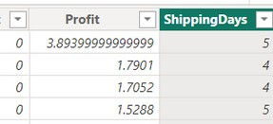

DATEDIFF
The DATEDIFF function in DAX is used to calculate the difference between two dates. The function returns the difference in terms of specified units such as days, months, quarters, or years.
Easy?
Syntax
DATE(<year>, <month>, <day>)
^{Example} Let's assume you have a table named Orders with the following columns:
OrderDate: The date the order was placed.
ShipDate: The date the order was shipped.
You want to calculate the number of days it took to ship each order.
Orders[OrderDate]: The start date for the calculation.
Orders[ShipDate]: The end date for the calculation.
DAY: Specifies that the difference should be calculated in days.

Slide 5

YEAR/MONTH/QUARTER
The YEAR, MONTH, and QUARTER functions in DAX are used to extract the respective parts of a date. These functions are helpful when you need to analyze data by year, month, or quarter.
1. YEAR Function :The YEAR function returns the year component of a date.
Easy dax
Syntax
YEAR(<date>)
2. MONTH : MONTH function returns the month component of a date.
Syntax
MONTH(<datetime>)
3. QUARTER : The QUARTER function returns the quarter of the year from a date, where 1 represents January to March, 2 represents April to June, 3 represents July to September, and 4 represents October to December
Syntax
DAY(<date>)

Slide 6



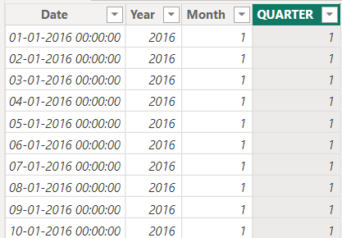
Examples
YEAR : Extract the year from the date column
Understood?
MONTH :Extract the Month from the date column
QUARTER : Extract the Quarter from the date column

Slide 7


Thank you for joining me today to learn about Part -43 of Power BI!
Remember, Learning DAX is key to unlocking the full potential of Power BI for insightful reporting and visualization.
Stay tuned for more insights and tips on Power BI in our next Series.
Follow
Siddhika Shah

